Slide 1

Os Assignment 3
Sachin Rajbhar
41221139
BCA 2ND SEm

Slide 2
Demonstrate, how to load the Operating System?
Windows on an unpartitioned harddisk
Windows on a partitioned hard disk with 2 or more partitions
Using any version of Windows (7 or above)

Slide 3
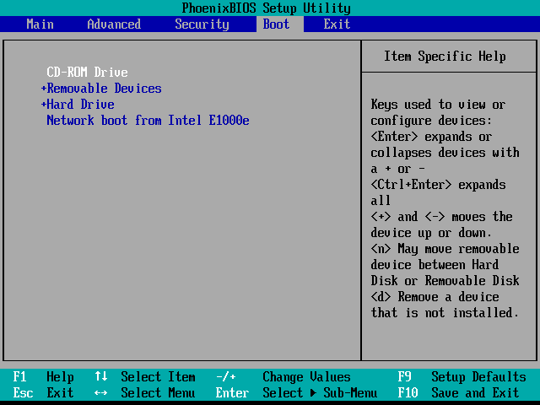
Step 1. Configuring your computer’s BIOS*
Start by inserting your Windows 10 installation media into the PC.
Now restart the computer and enter the BIOS (F2, F9, F12, or Del on most PCs).
I’ll be using a DVD, so I’ll place “CD-ROM Drive” at the top. If you use a USB drive, you should move “USB Device” or “Removable Devices” to the top.

Slide 4
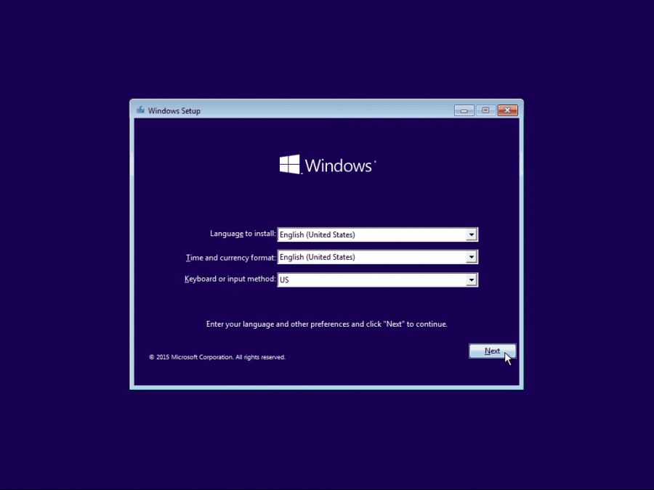
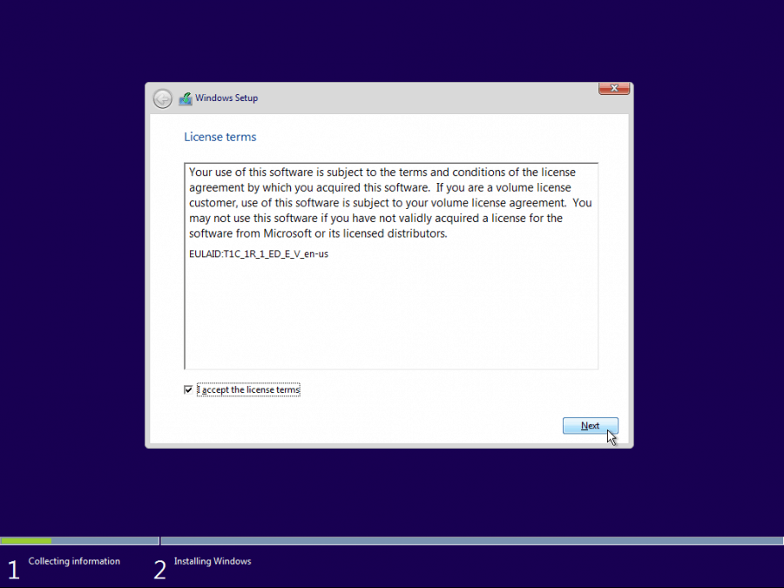
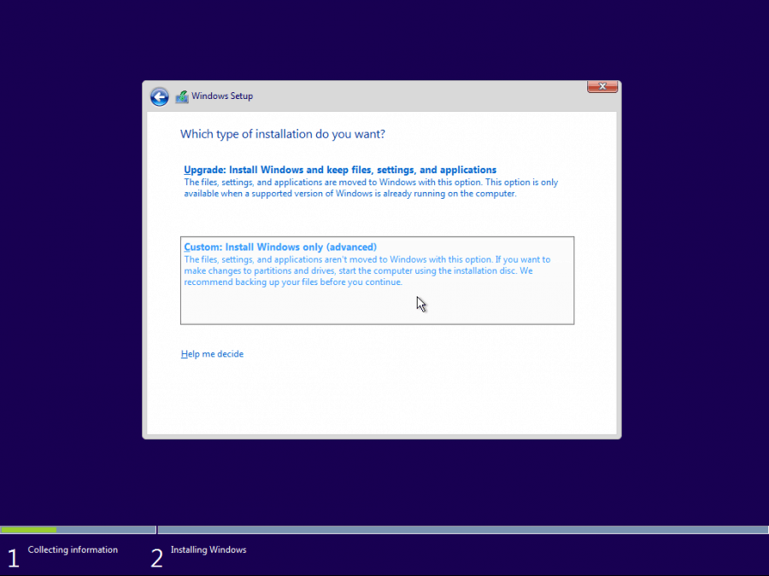
Step 2. Installing Windows 10
After rebooting, you should see the Language select screen.
Then press Next to continue.
On the next screen, press the “Install now” button.

Slide 5
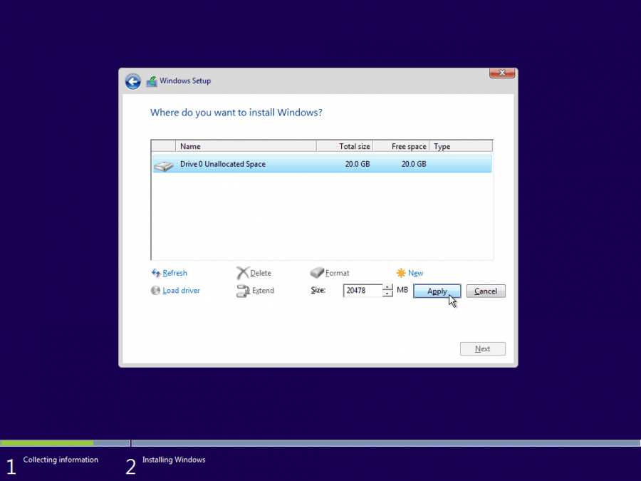
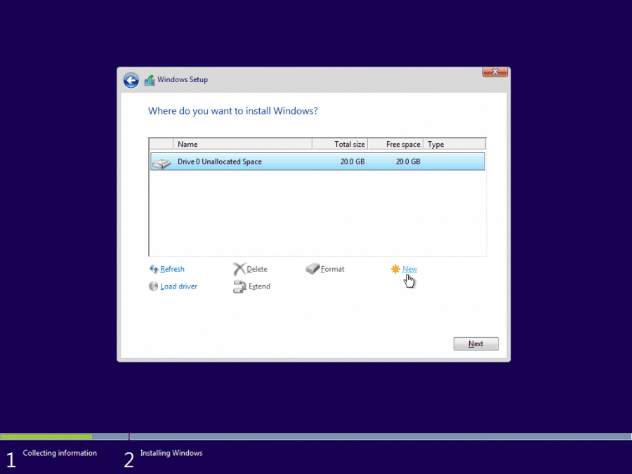
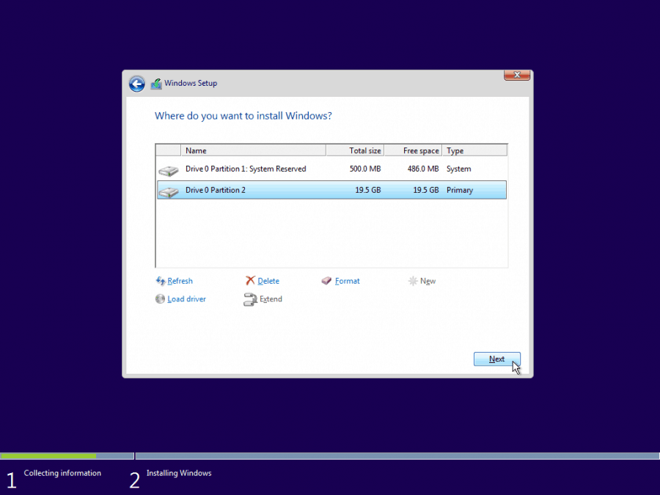
(1) Unpartitioned Hard Disk
Select it and click the “New” button to create a new partition.

Slide 6
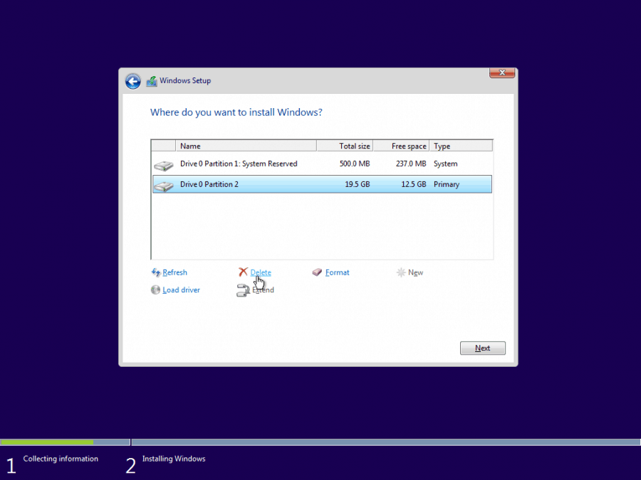
(2)Partitioned Hard Disk

Slide 7
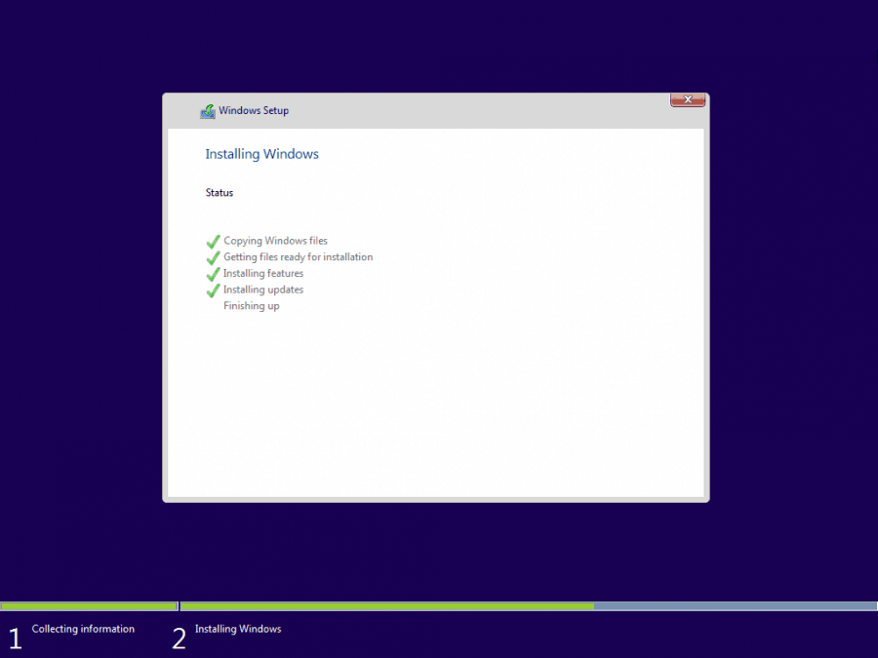
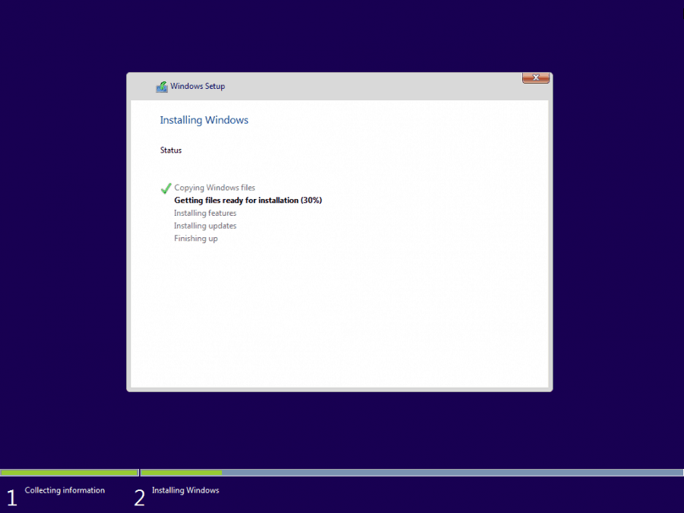
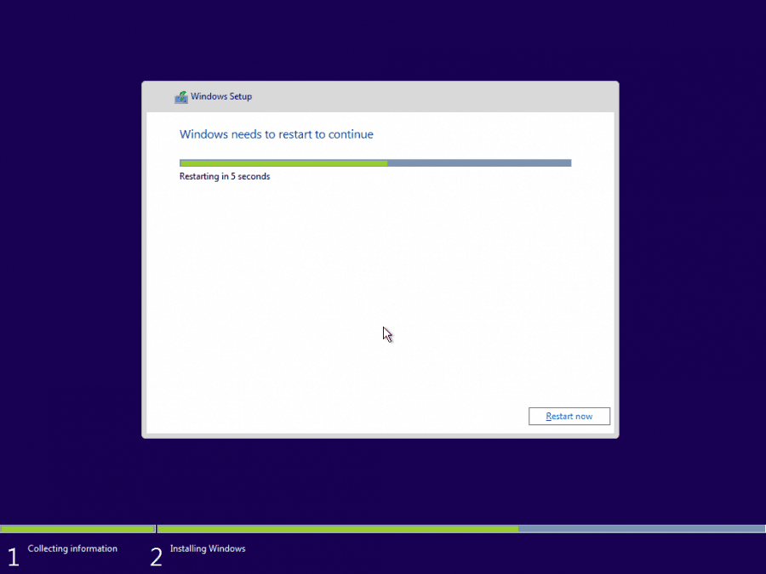
The Windows setup should now begin.
Clean installs are usually significantly faster
than upgrades, so you should get from this…

Slide 8

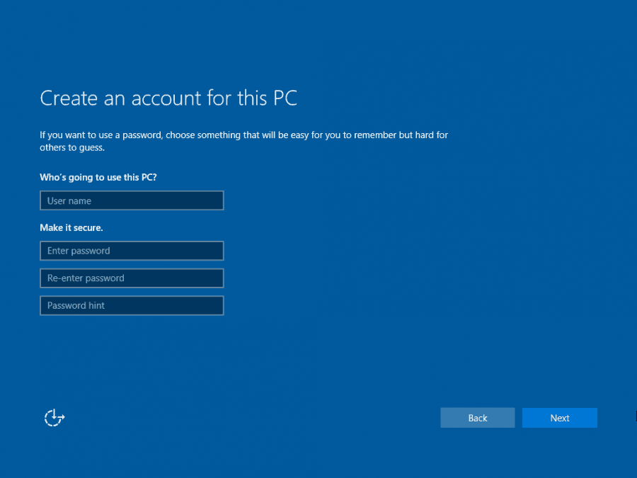
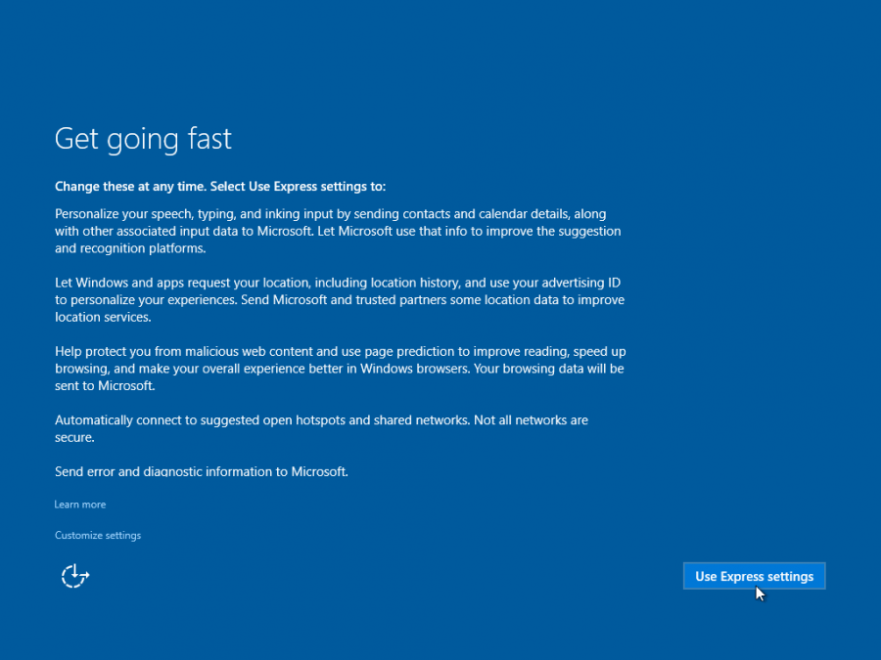
SET UP

Slide 9
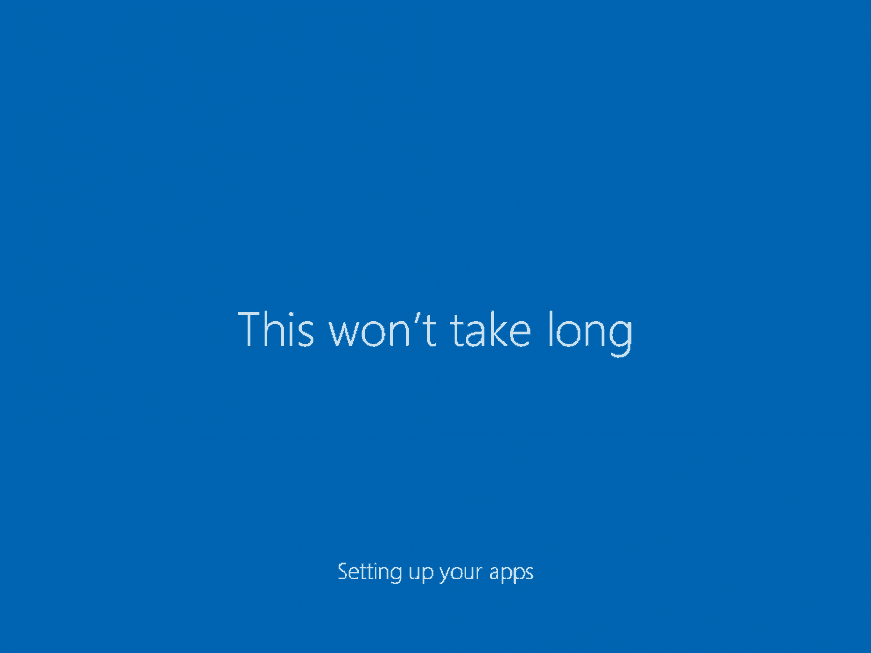
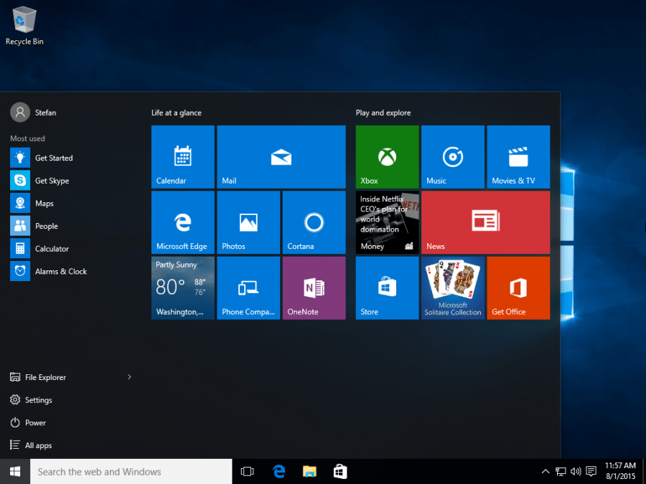

Slide 10

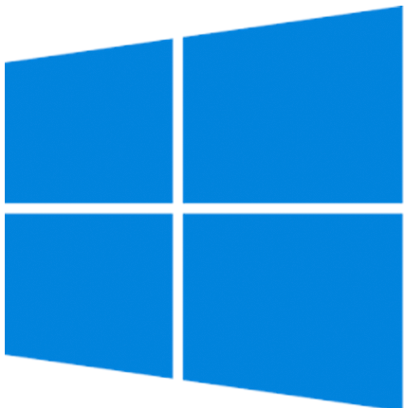

Thank YOu

